Slide 1
Brane Calculi
CS694A – Computational Biology
Michael Fang

Slide 2
Contents
1. Overview of Membranes
2. Brane Calculi syntax
3. Bitonal Reactions and Derivations
4. Molecules and Reactions
5. Example: Neurotransmission

Slide 3
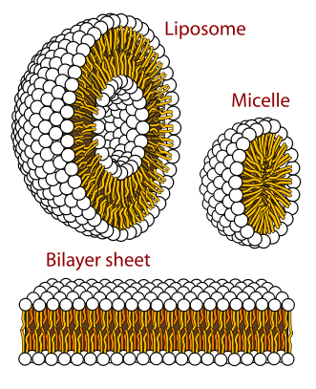
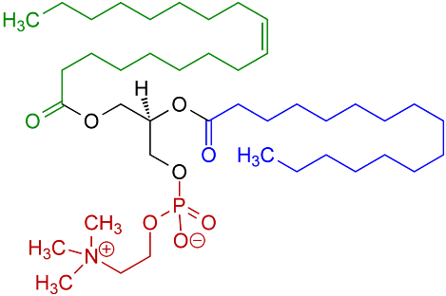
Membrane overview: Phospholipids
Phosphatidylcholine
https://en.wikipedia.org/wiki/File:Phospholipids_aqueous_solution_structures.svg

Slide 4
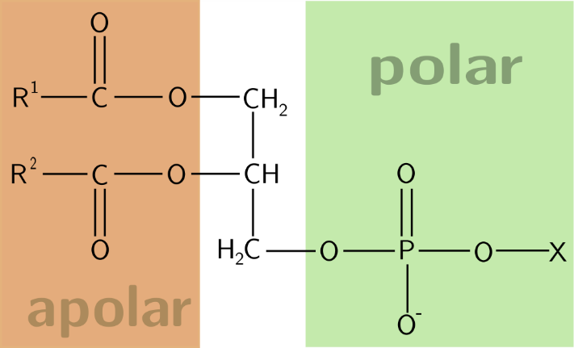
Hydrophobicity
Three general categories for molecules in water:
1. Hydrophilic – “water-loving”, charged molecules (sulfates RSO₄⁻; phosphates (PO ₄ ³⁻))
2. Lipophilic – “fat-loving”, long hydrocarbon chains (CH₃(CH₂)_{n}, with n > 4)
3. Amphiphile – “both-loving”, possess both hydrophilic and lipophilic properties (estradiol, testosterone)
Note: Lipophilic is not to be confused with hydrophobic, though the distinction is minor here
https://en.wikipedia.org/wiki/Amphiphile#/media/File:Phospholipid.svg

Slide 5
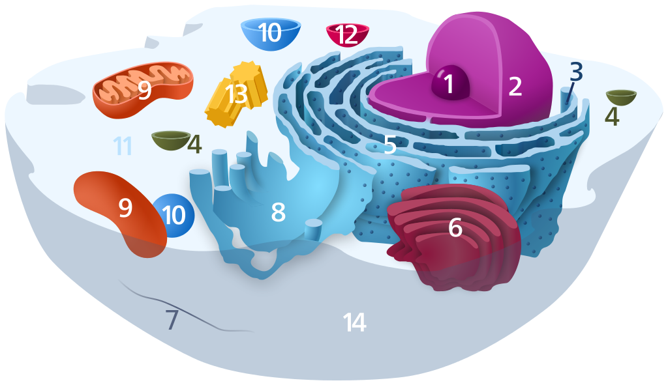
Functionality
1. Separate components from surroundings
A. prokaryote: only 1 lipid bilayer – the cell membrane
B. eukaryote: organelles – nucleus, mitochondria, lysosome, endoplasmic reticulum
Nucleolus
Nucleus
Ribosomes
Vesicles
Rough endoplasmic reticulum
Golgi body or apparatus
Cytoskeleton (microfilament, microtubule, intermediate filament)
Smooth endoplasmic reticulum
Mitochondrion
Vacuole
Cytosol
Lysosome
Centrosome
Cell Membrane
https://en.wikipedia.org/wiki/Organelle#/media/File:Animal_Cell.svg

Slide 6
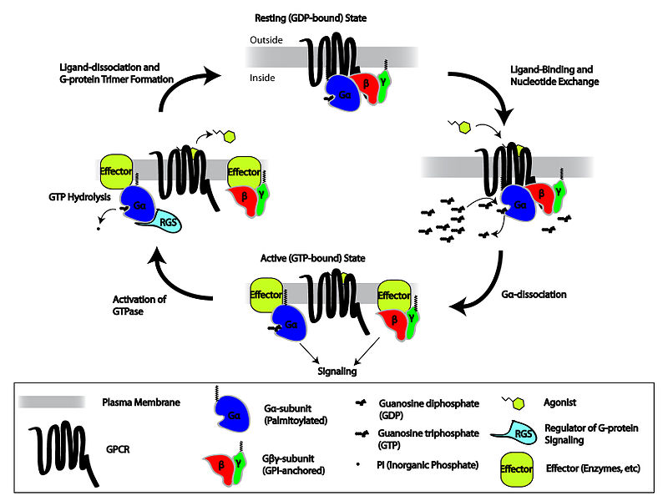
Functionality
2. Signaling
https://en.wikipedia.org/wiki/G_protein-coupled_receptor#/media/File:GPCR_cycle.jpg

Slide 7
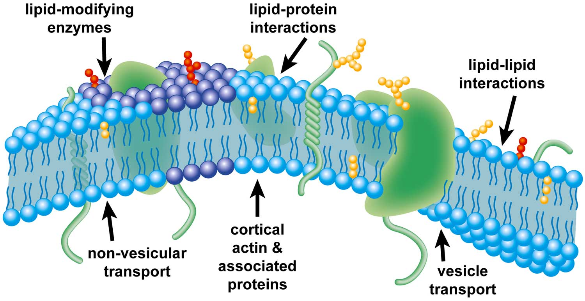
Membrane Domains
http://www.asbmb.org/asbmbtoday/201409/LipidNews/

Slide 8
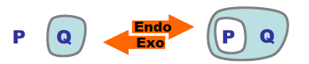
Brane Calculi, Part I
Considerations:
1. Orientation: Which side of the membrane are we on?
Binding sites for membrane-bound proteins are generally only found on one side.
2. Bitonality: objects nested in membranes have opposite orientations.
Example:
P remains surrounded by the ‘white background’ (hydrophobic effect) even when engulfed by Q
3. Layering: any “system” can have large sets of actions within it.

Slide 9
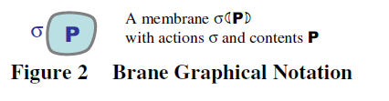
Brane Calculi, Syntax
Syntax:
o is a composition of systems, with unit ◊
This is the same as (g o f) (x) = g(f(x))
| is a composition of membranes, with unit 0
! is replication, for multiple of same elements
Systems consist of nested membranes, membranes consist of nested “actions” (1).
Reactions only occur at the level of Systems, caused by actions on membranes (1).

Slide 10
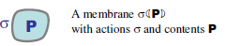
Brane Calculi, Syntax
Systems:
P o Q is composition of systems P and Q
!P is replication of same component P
δ (P) is a system or membrane with actions on the membrane δ and contents P
Ex: membrane (cytosol) (Cardelli p.7)
Membranes:
δ | τ is the composition of membrane parts δ and τ
!δ is replication of δ
a.δ is the action “a” associated with membrane part δ

Slide 11
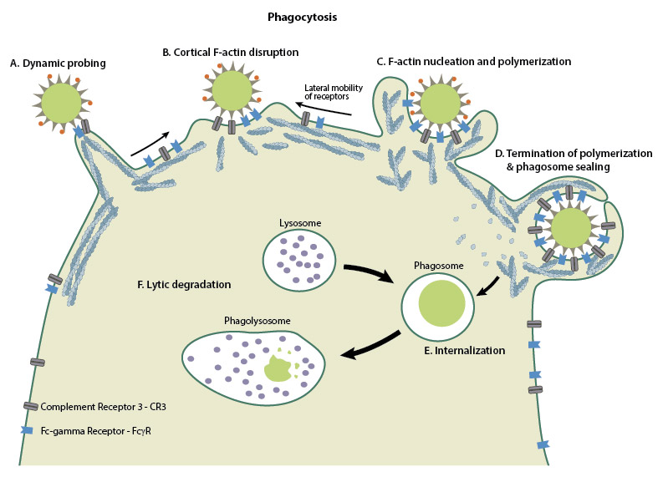
Bitonal Actions: Phagocytosis
https://www.mechanobio.info/what-is-the-plasma-membrane/what-is-membrane-trafficking/what-is-phagocytosis/

Slide 12
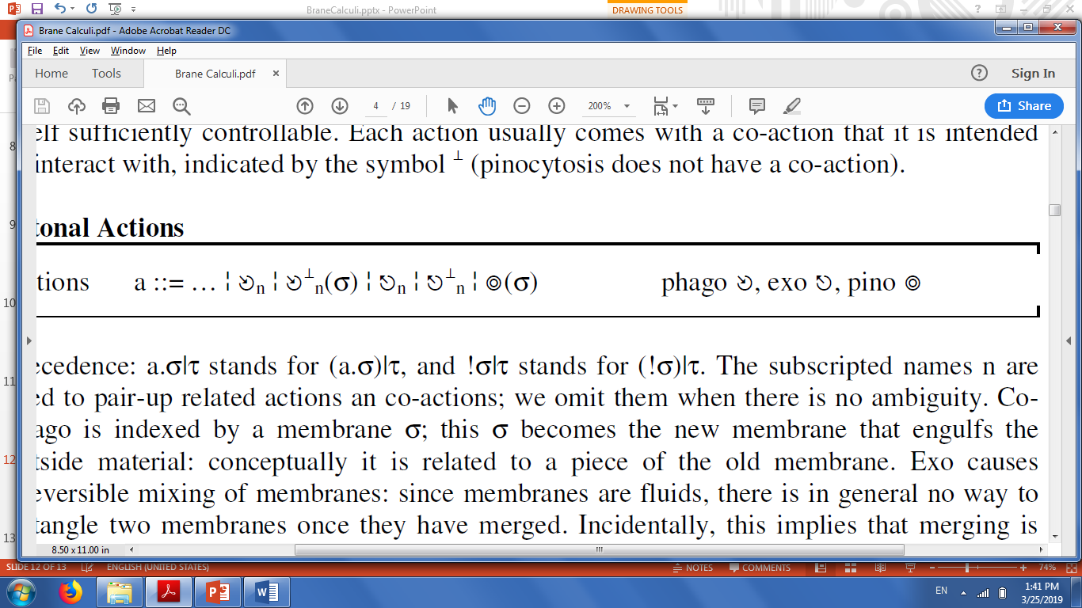
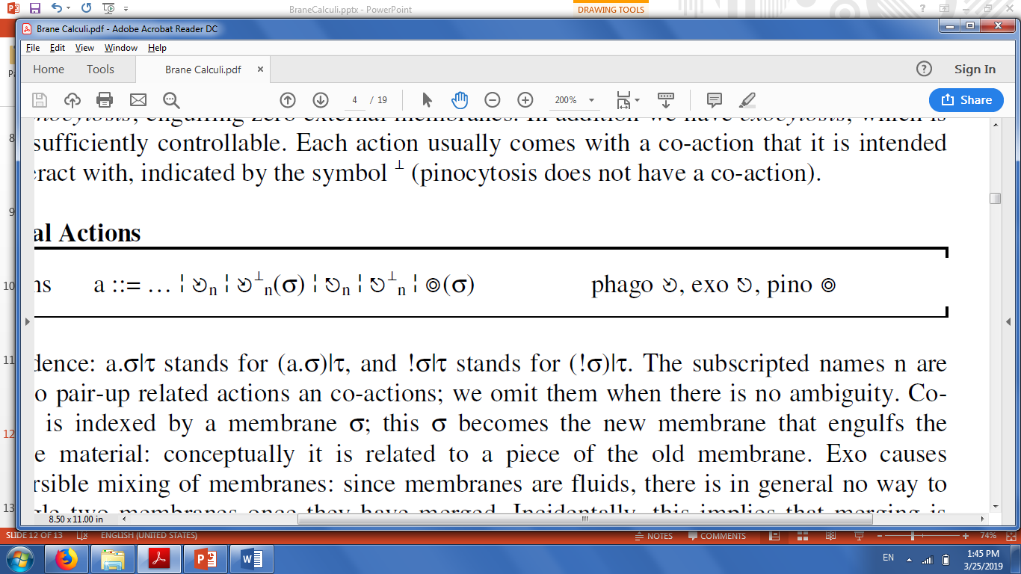
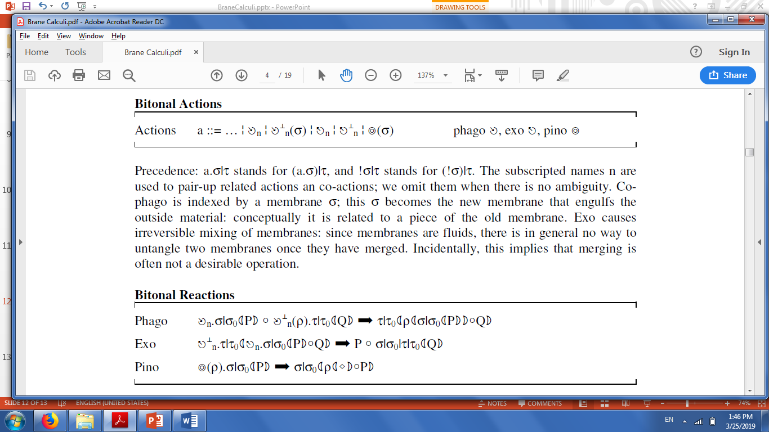
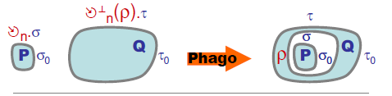
Bitonal Actions: Phagocytosis
Actions:
a ::= phagocytosis
Use symbol for paired “co-actions”:
Bitonal Reaction:
https://upload.wikimedia.org/wikipedia/commons/b/ba/Phagocytosis_in_three_steps.png

Slide 13
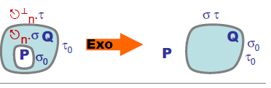
Bitonal Actions: Exocytosis
Actions:
a ::= exocytosis

Slide 14
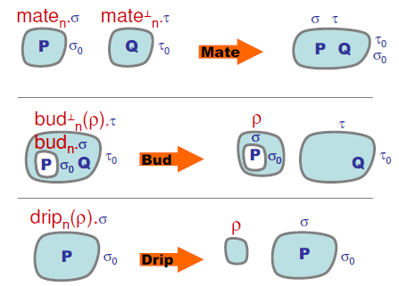
Derivations

Slide 15
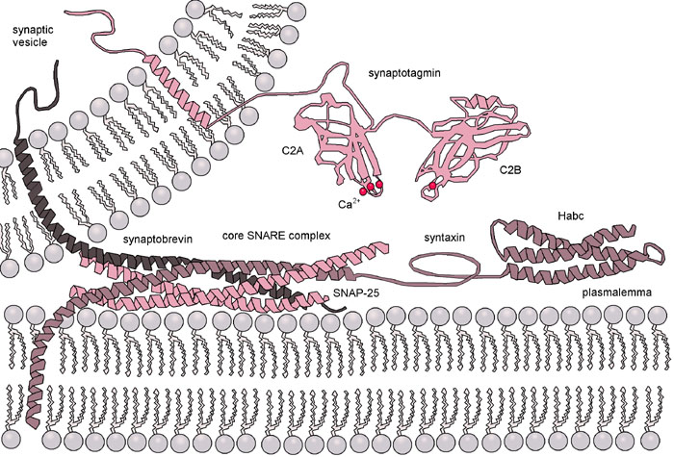
An Aside
Phagocytosis/Endocytosis/Exocytosis is very complicated!
https://upload.wikimedia.org/wikipedia/commons/9/90/Exocytosis-machinery.jpg

Slide 16
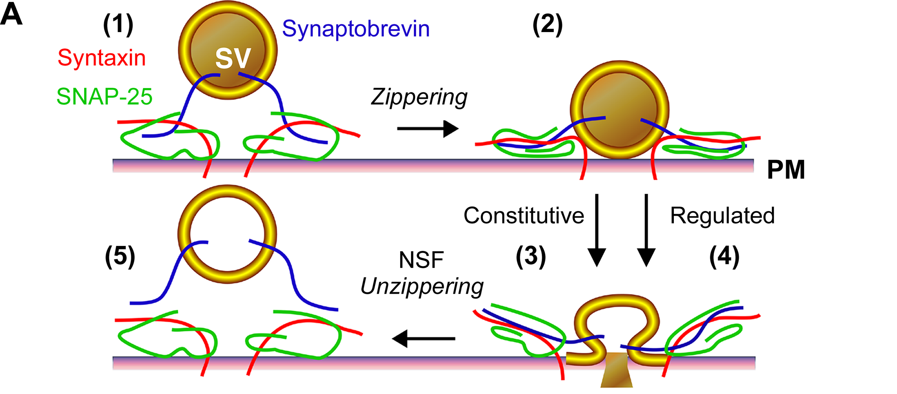
Exocytosis:
https://upload.wikimedia.org/wikipedia/commons/2/28/Opening_of_a_Fusion_Pore_during_Exocytosis.png

Slide 17
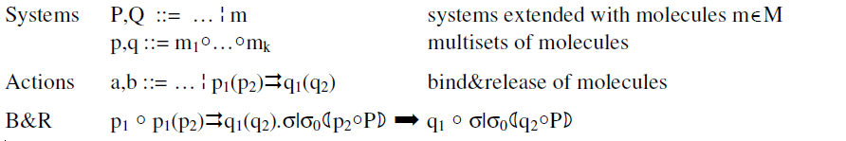
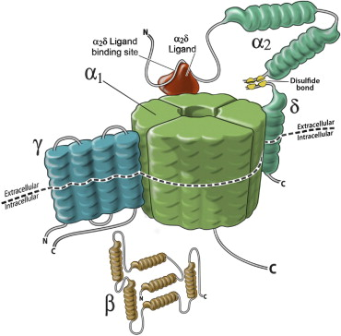
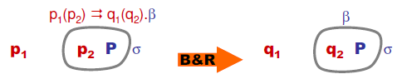
Molecules
https://www.sciencedirect.com/science/article/pii/S1084208X10000200

Slide 18
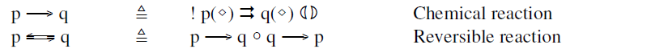
Chemistry!
We may represent enzyme-catalyzed reactions as a an empty membrane an bind-outside & release-outside action

Slide 19
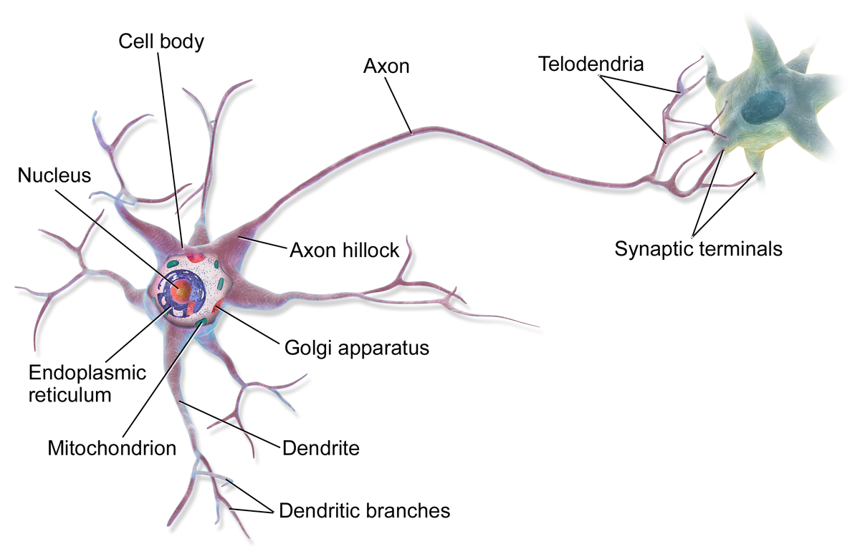
Example: Neurotransmission
https://upload.wikimedia.org/wikipedia/commons/thumb/1/10/Blausen_0657_MultipolarNeuron.png/1200px-Blausen_0657_MultipolarNeuron.png

Slide 20
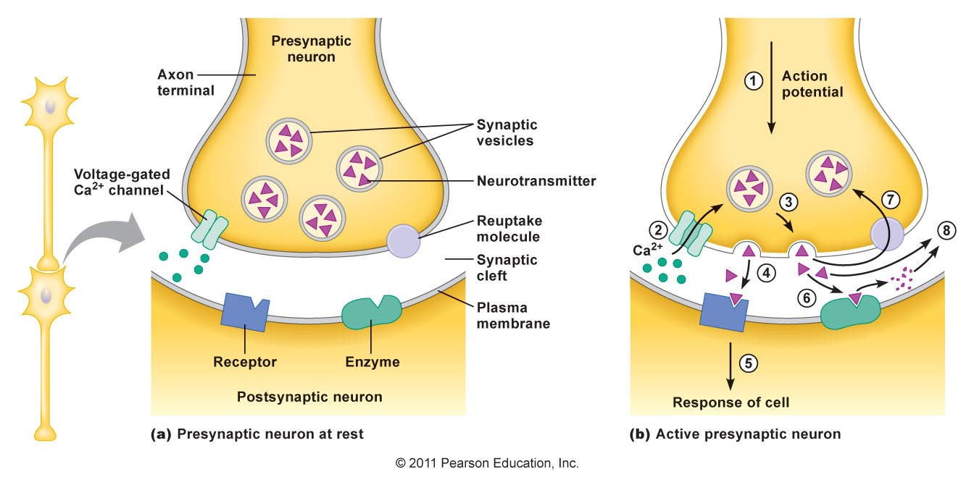
Synaptic Terminal
http://droualb.faculty.mjc.edu/Course%20Materials/Physiology%20101/Chapter%20Notes/Fall%202011/chapter_8%20Fall%202011.htm

Slide 21
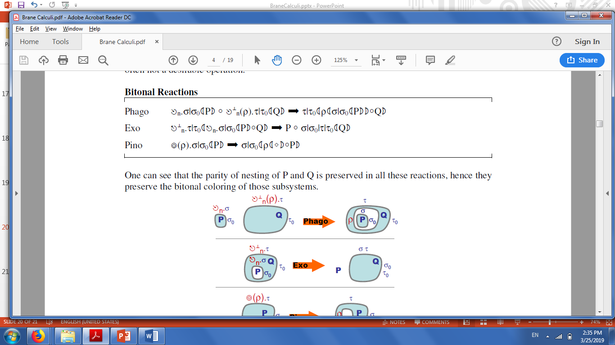
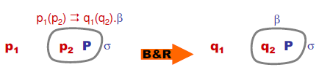
Neurotransmission in Brane Calculi
Step 1) Exocytosis of Neurotransmitter:
Step 2) Chemical reaction on second cell membrane (section 4.5):
We sequence this action with the membrane

Slide 22
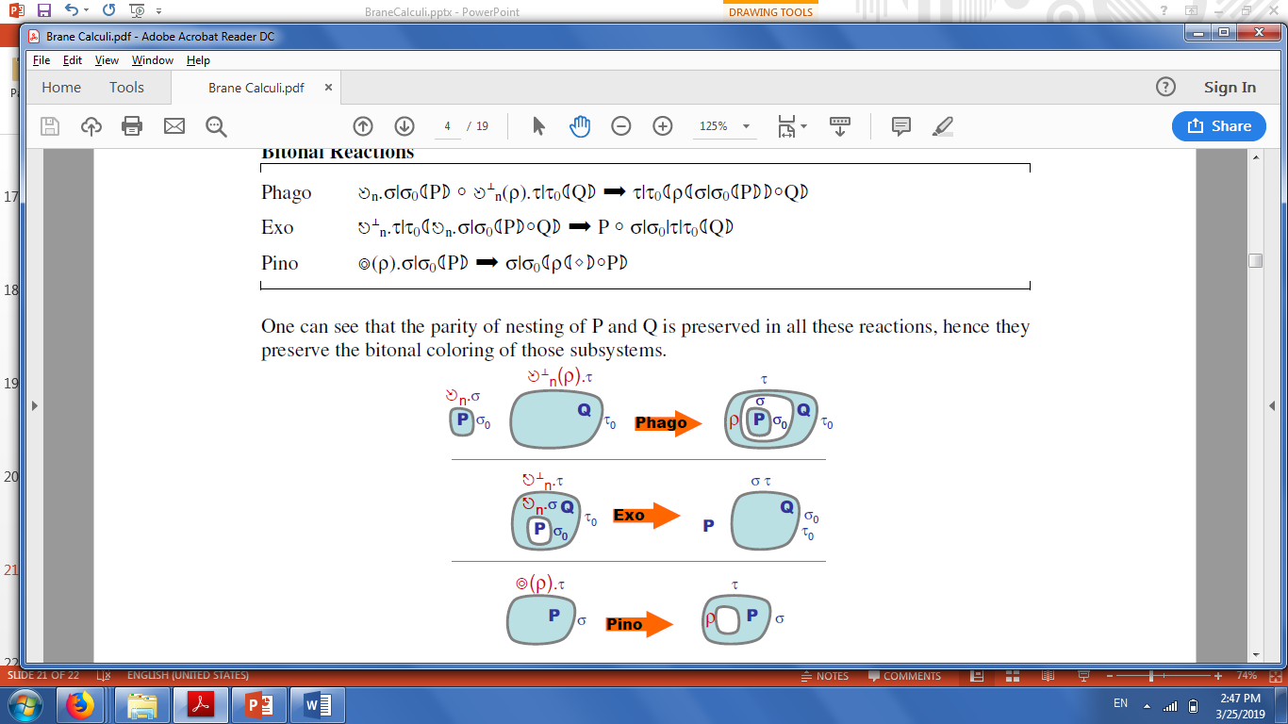
Neurotransmission in Brane Calculi
Step 3a) Reuptake of Neurotransmitter – pinocytosis or phagocytosis of molecule
Step 3b) AND/OR degredation of Neurotransmitter (5.4)
p -> q == p (◊) -> q (◊).δ (), where q is NT fragments

Slide 23
Bibliography
1. Cardelli, L. Brane Calculi: Introduction of Biological Membranes. Microsoft Research. 2004-06-01 12:35:58

